Slide 1
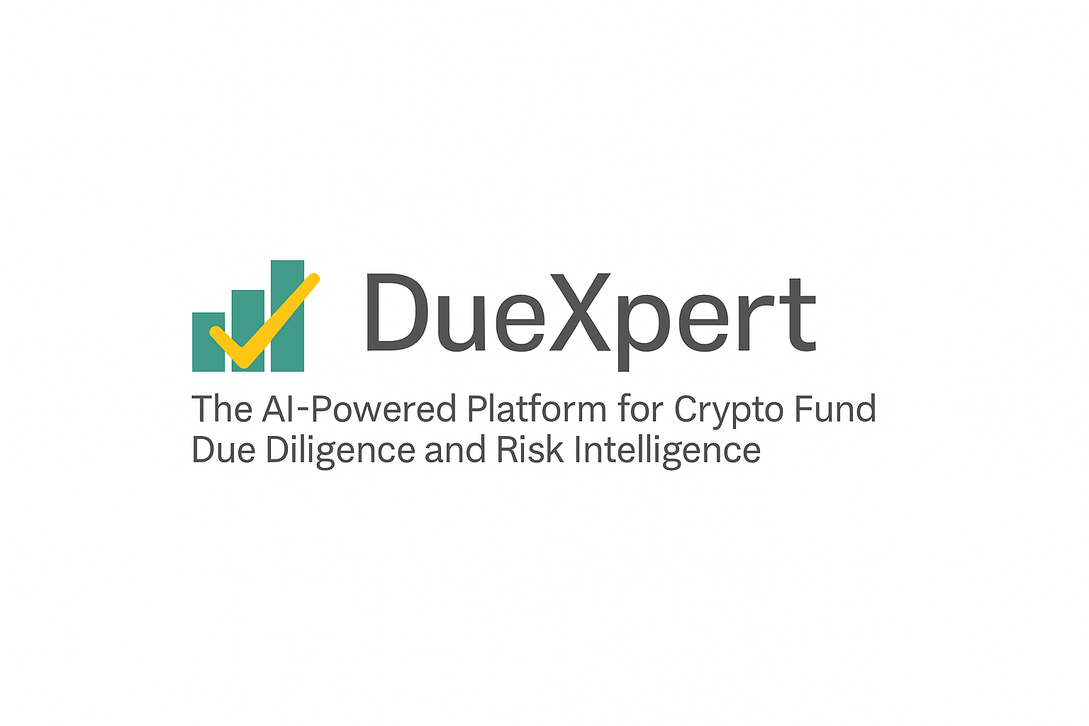
Due Diligence Report
Prepared by DueXpert | 2025-04-25
DueXpert – AI Crypto Fund Due Diligence Suite | info@duexpert.ai | www.duexpert.ai

Slide 2
CONTENTS
1. CYBERSECURITY & DATA PRIVACY
3

Slide 3
3. Cybersecurity & Data Privacy
Objective: Examine the strength of cybersecurity practices and safeguards for user and company data.
Key Findings:
• Multi-layer cybersecurity practices are in place, including two-factor authentication and end-to-end encryption.
• Sensitive data is handled via controlled access and encrypted storage.
• Systems are routinely audited to detect potential vulnerabilities.
Outstanding Issues:
• No public documentation of third-party penetration testing available.
• Lack of detail on how intrusion attempts are monitored in real-time.
• Limited disclosure on historical breach incidents, if any.
Page 3
DueXpert – AI Crypto Fund Due Diligence Suite | info@duexpert.ai | www.duexpert.ai

